Slide 1
YottaDBTM Foundation Comsan Chanma (Neo) T.N. Incorporation Ltd.

Slide 2
About Me
Department Manager, SE-Excellence Performance Lab Team, T.N. Incorporation Ltd.
17 years’ experience on GT.M and YottaDB database ( PROFILE CBS Project).
SE Data Engineer Team Leader.
Performance Testing Specialist.

Slide 3
Agenda
1st Day.
Database Principle
Introduction to YottaDB
YottaDB User Command
YottaDB Administrator Command
YottaDB Installation
YottaDB DB Structure

Slide 4
Database Principle (SQL VS. NoSQL)

Slide 5
Relational and non-relational defined
Relational databases (RDBMS, SQL Databases)
Example: Microsoft SQL Server, Oracle Database, IBM DB2, MySQL
Mostly used in large enterprise scenarios
Analytical RDBMS (OLAP, MPP) solutions are Analytics Platform System, Teradata, Netezza
Non-relational databases (NoSQL databases)
Example: YottaDB, Azure Cosmos DB, MongoDB, Cassandra
Four categories: Key-value stores, Wide-column stores, Document stores and Graph stores

Slide 6
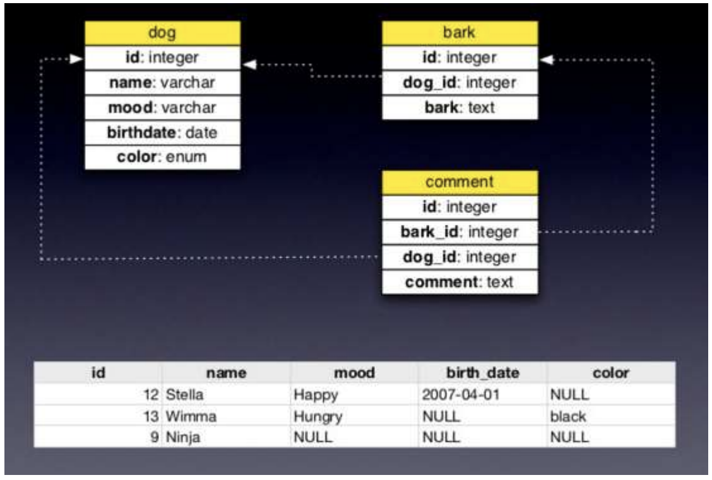
Relational Store
Data stored in tables.
Tables contain some number of columns, each of a type.
A schema describes the columns each table can have.
Every table’s data is stored in one or more rows.
Each row contains a value for every column in that table.
Rows aren’t kept in any particular order.

Slide 7
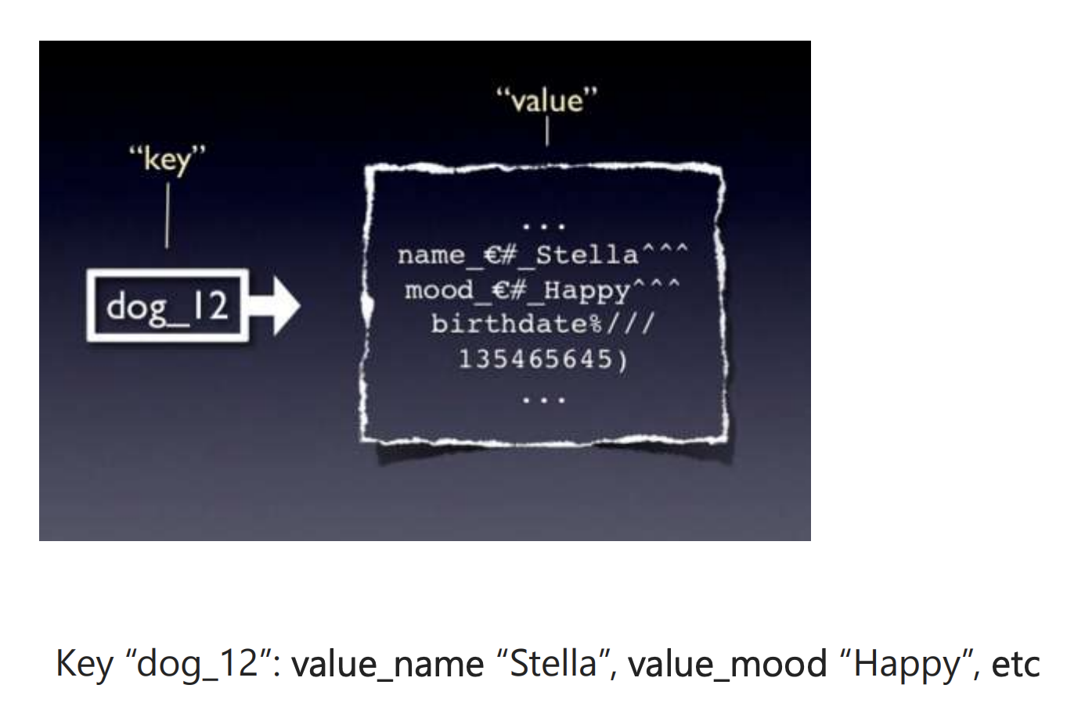
Key-Value Stores
Key -value stores offer very high speed via the least complicated data model
anything can be stored as a value, as long as each value is associated with a key or name.

Slide 8
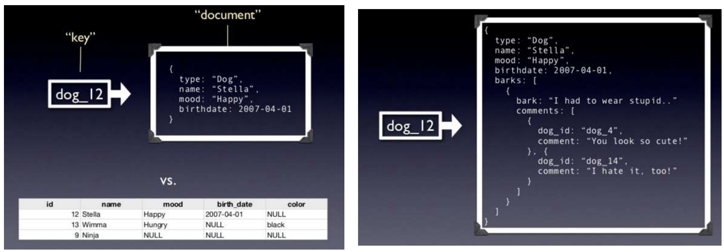
Document Stores
Document stores contain data objects that are inherently hierarchical, tree-like structures (most notably JSON or XML). Not Word documents!

Slide 9
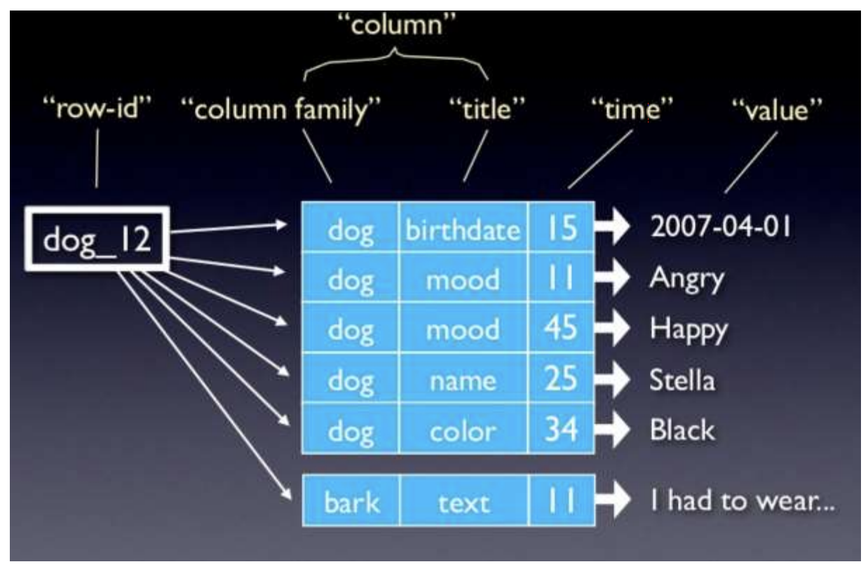
Wide-Column Stores
Wide-column stores are fast and can be nearly as simple as key-value stores.
They include a primary key, an optional secondary key, and anything stored as a value. Also called column stores

Slide 10
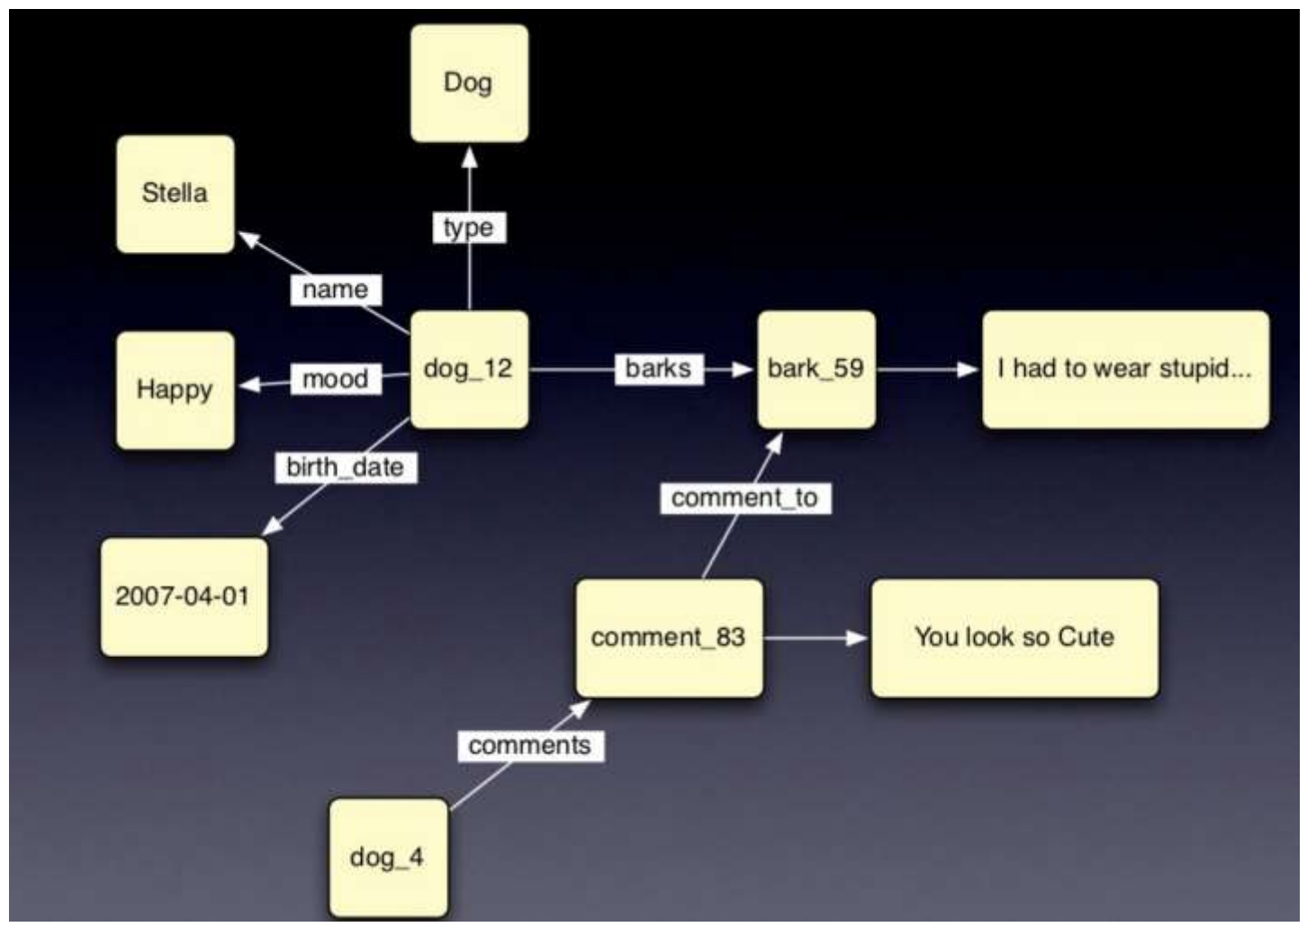
Graph Stores
Schema-less, based on graph theory.
Only two types of data inside the graph database.
Node and relationship (edge) .
Widely use in social network system and large scale website architecture.

Slide 11
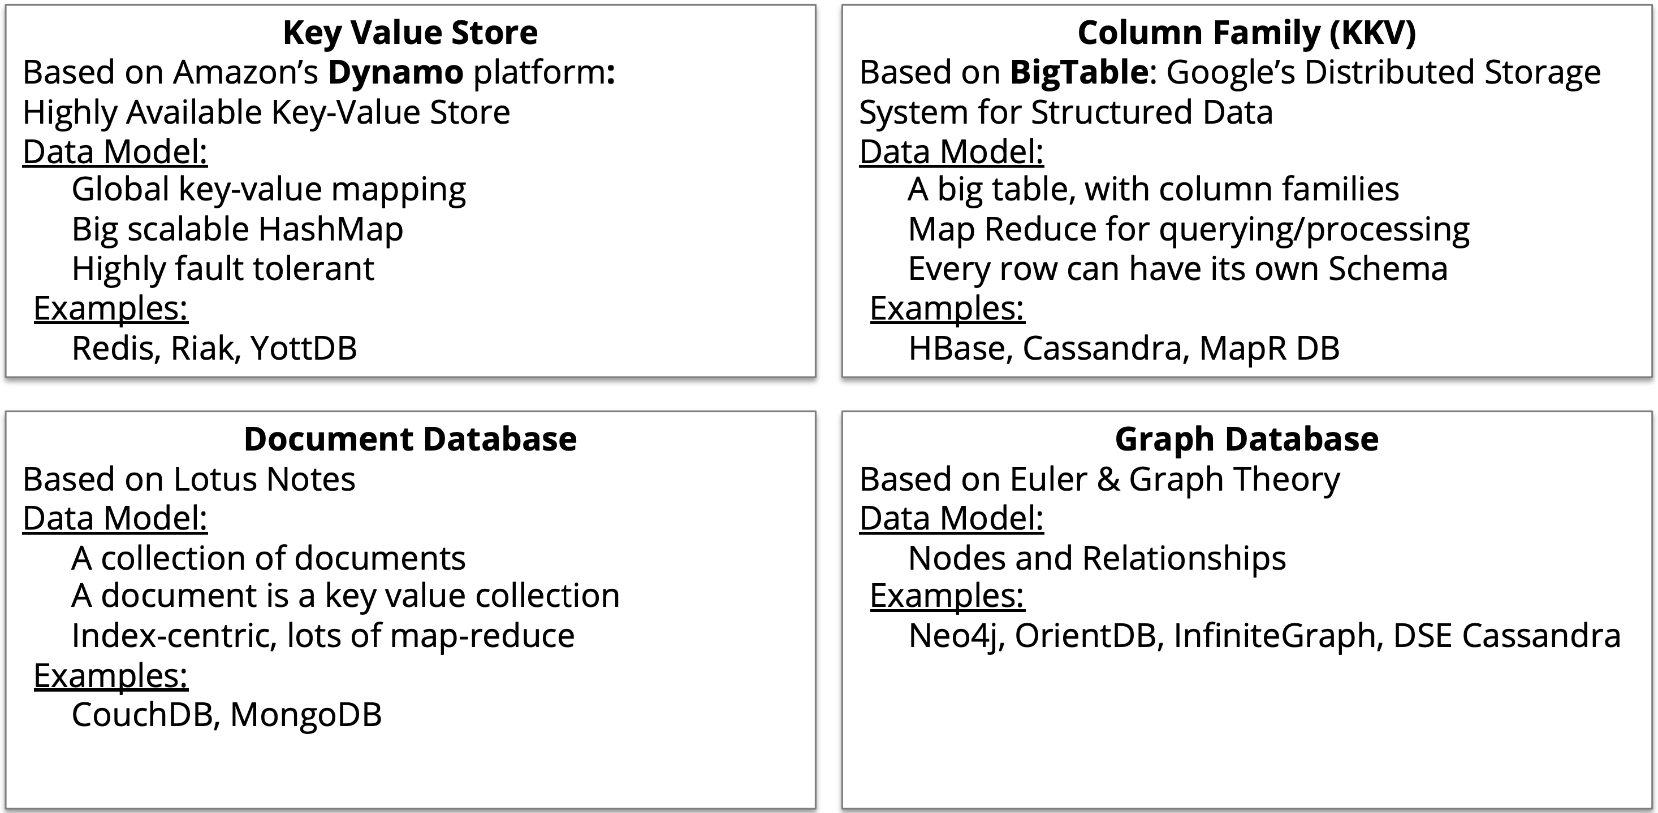
NoSQL Database

Slide 12
Relational Database : Pros
Works with structured data
Supports strict ACID transactional consistency
Supports joins
Built-in data integrity
Large eco-system
Relationships via constraints
Limitless indexing
Strong SQL
OLTP and OLAP
Most off-the-shelf applications run on RDBMS

Slide 13
Relational Database : Cons
Does not scale out horizontally (concurrency and data size) – only vertically, unless use sharding
Data is normalized, meaning lots of joins, affecting speed
Difficulty in working with semi-structured data
Schema-on-write
Cost

Slide 14
NoSQL : Pros
Works with semi-structured data (JSON, XML)
Scales out (horizontal scaling – parallel query performance, replication)
High concurrency, high volume random reads and writes
Massive data stores
Schema-free, schema-on-read
Supports documents with different fields
High availability
Cost
Simplicity of design: no “impedance mismatch”
Finer control over availability
Speed, due to not having to join tables

Slide 15
NoSQL : Cons
Weaker or eventual consistency (BASE) instead of ACID
Limited support for joins, does not support star schema
Data is denormalized, requiring mass updates (i.e. product name change)
Does not have built-in data integrity (must do in code)
No relationship enforcement
Limited indexing
Weak SQL
Limited transaction support
Slow mass updates
Uses 10-50x more space (replication, denormalized, documents)
Difficulty tracking schema changes over time
Most NoSQL databases are still too immature for reliable enterprise operational applications

Slide 16
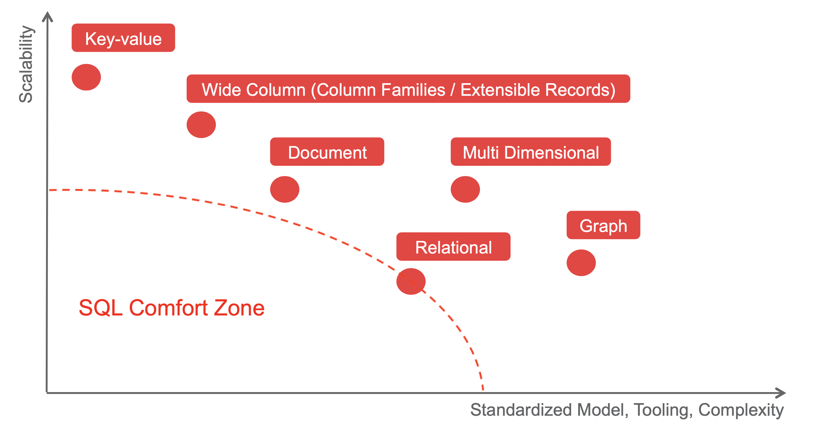
Data store Positioning

Slide 17
Introduction to YottaDB

Slide 18
YottaDB – https://yottadb.com
A NoSQL database with a proven, mature code base that both scales up to enterprise-scale applications and scales down to the needs of embedded systems.
Rock Solid. Lightning Fast. Secure. Pick any three.

Slide 19
YottaDB is a NoSQL database
Data is stored as a hierarchy of key-value data
i.e., [“people”, “sanchez”, “rick”, “alive”]=”?”
Very good for data which has hierarchy
Where in SQL you would have a related table, you instead represent it as a “subscript” of the parent key

Slide 20
YottaDB Characteristics
Data is “type-less”
Relationships can be described as:
Hierarchical
Multi-dimensional sparse arrays
Content-associative memory
Daemon-less
Built-in M language (compiled and interpret)
Transaction processing support (ACID)
Very fast database operation (read / write)

Slide 21
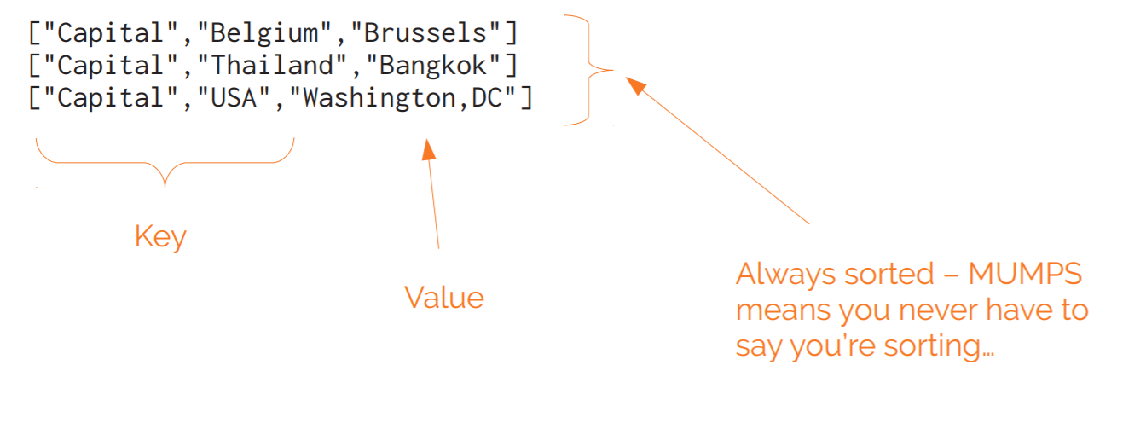
Key-Value Tuples

Slide 22
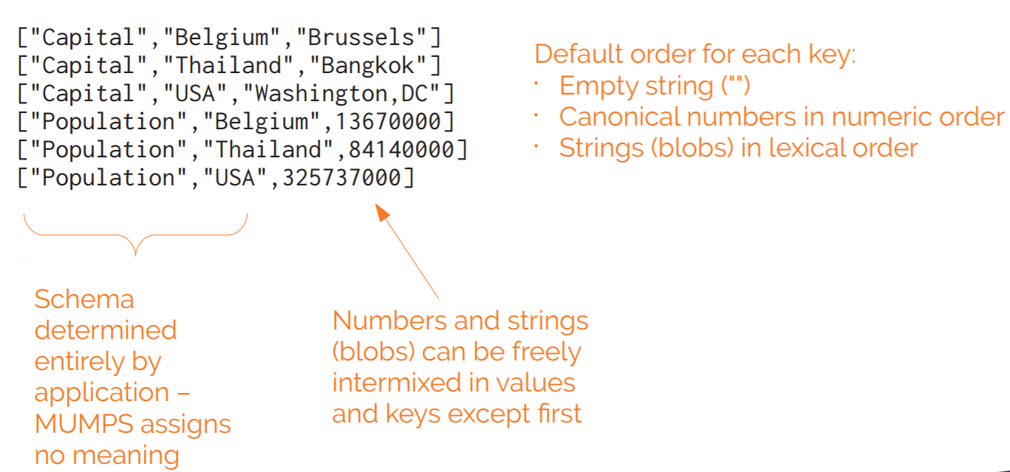
Schemaless

Slide 23
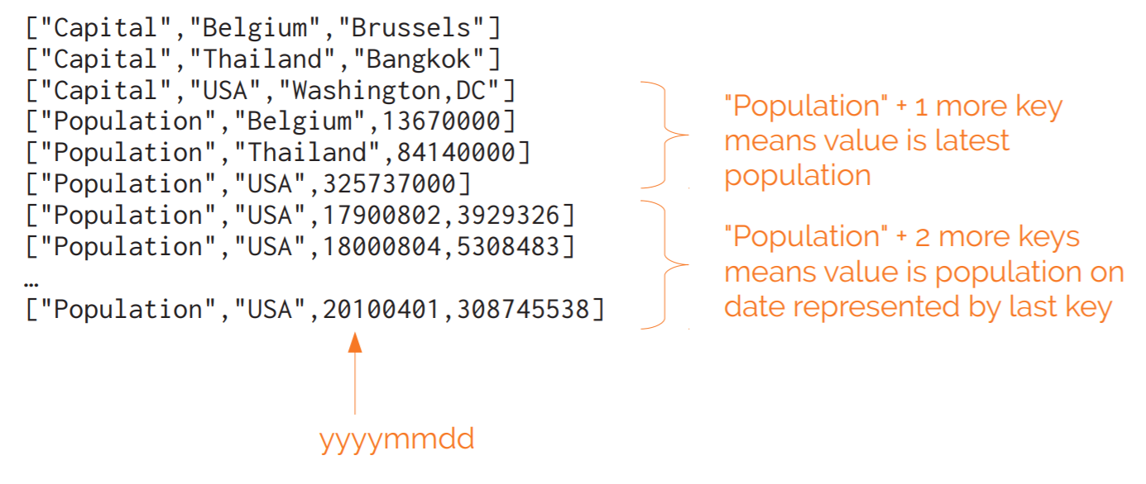
Mix Key Sizes

Slide 24
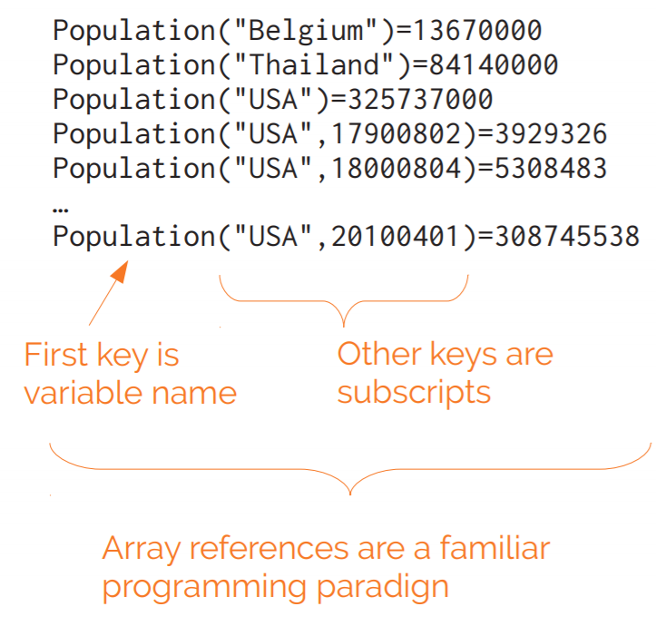
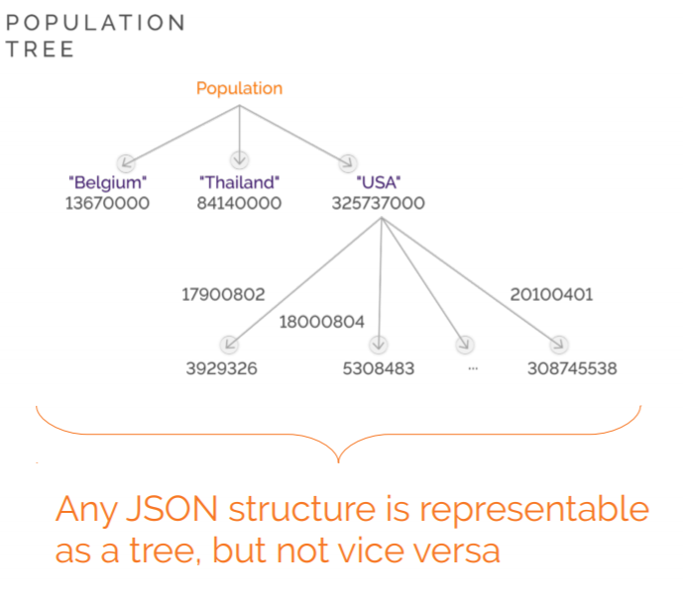
Keys Array References

Slide 25
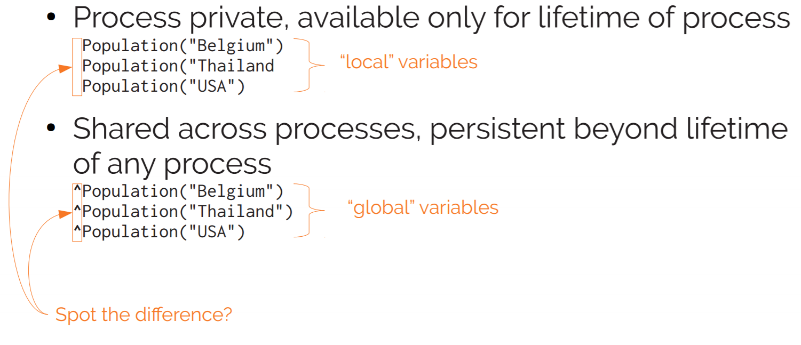
Sharing and Persistence – Database Access

Slide 26
Multi-dimensional sparse arrays
Physical YottaDB database record example
^ACN(19,1)=“สมชาย สายชม"
^ACN(19,49)="|0|3||13||||0|||3|||0|||||||||0||||||||||||1|2|0|||||1|1|1"
^ACN(19,50)="2001|D|SAV||1|สายชม,สมชาย|200000|0|0||0|THB|1||SAV1|0|0|0|||20
AA|KTB|||0|0|0||0|||0"
^ACN(19,51)="0|60383|||5|6|0|0|||||0|59931|1|||0||60383|0||||||||||0||0||1"
^ACN(19,52)="0|59791||||0.75000||||||||||||||||0"
^ACN(19,53)="||100||||||||||||||0"
^ACN(19,54)="0|0|60388||||-363.24|0||0|0|||0.00000|1|||0|||||0||||||||0|0.00000|
0|0.00000|0||||||0||0|||PER1|||||||||||||0.00000|0||0.00000|0|||||||||||0||0"
^ACN(19,55)="|0|0||||||0"
^ACN(19,57)=".75|2|60389|60388|60446|60265||||||||||||0|||||||||||||||||||60416|
60385||||||||||0"
^ACN(19,60)="SAV002|JUN30DEC31|||1DA||||||||||||||||||||||||||||||||||||||||||||
|||||||||1MAE|0|||99Y"
^ACN(19,61)="||||||||||||||||||||||||||||0||0||0"

Slide 27
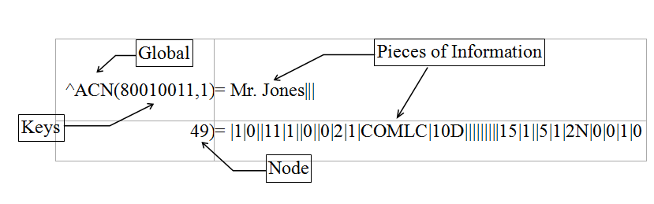
Global
A global is a structured representation of the physical data located in the database. Profile uses the string method of global placement (i.e., multiple nodes hold multiple pieces of information). Pieces of information are located by global name and key and are separated by delimiters (“|”).
Example:
The first two nodes of an Account Record might look like this:

Slide 28
YottaDB is Daemon-less
Process that access YottaDB has to perform database processing logic
Mumps
Process
Mumps
Process
Mumps
Process
Mumps
Process
Mumps
Process
Database Buffer Cache
(IPC -- shared memory, semaphore)
YottaDB Database File

Slide 29
YottaDB User Command

Slide 30
YottaDB Access
Use “yottadb” command or “mumps” command (GT.M traditional style) for YottaDB local access.
Use M command (M programming language) to manage the data.

Slide 31
YottaDB Invocation Mode
-direct: Invokes YottaDB in direct mode where you can enter M commands interactively.
<list of M source files>: Invokes YottaDB in compiler mode, invoke YottaDB by entering a list of file names to compile as an argument. YottaDB then compiles the specified programs into .o files, UNIX shell globbing to resolve wild-cards (* and ?) in names.
-run ^routine_name: -r invokes YottaDB in auto-start mode. The second argument is taken to be an M entryref, and that routine is automatically executed, bypassing direct mode. Depending on your shell, you may need to put the entryref in quotes.

Slide 32
YottaDB User Command Example
Access and exit from YDB Prompt
Check YottaDB Version
List Global
List mumps file and free space
Show Global contents
Set, Write and Kill Global
Manipulate data in piece
Merge Global

Slide 33
Access to YDB Prompt
Access YDB Prompt
$ cd /ydbdir
$ . ./ydbenv
$ yottadb -direct
YDB>
Exit from YDB Prompt
YDB>HALT
$
YDB>H
$

Slide 34
Check YottaDB Version
YDB>WRITE $ZVERSION
YDB>W $ZVER

Slide 35
List Global
YDB> d ^%G
Output device: <terminal>:
List ^?D
Global Directory
Global ^*
^%ydboctoocto ^%ydboctoschema
Total of 2 globals.
Global ^

Slide 36
List mumps files and free space
YDB> d ^%FREECNT
Region Free Total Database file
------ ---- ----- -------------
DATA 94 100 ( 94.0%) /ydbdir/gbls/mumps.data
OCTO 56 100 ( 56.0%) /ydbdir/gbls/mumps.octo
YDB>

Slide 37
Set Global value
YDB>S ^ZTEST(1)="one"
YDB>S ^ZTEST(2)="two"
YDB>S ^ZTEST(1,1)="one,one"
YDB>S ^ZTEST(1,2)="one,2"
YDB>S ^ZTEST(300)=300
YDB>S ^ZTEST("FIVE")=555
YDB>S ^ZTEST="ABCDEFG"
YDB>ZWR ^ZTEST
^ZTEST="ABCDEFG"
^ZTEST(1)="one"
^ZTEST(1,1)="one,one"
^ZTEST(1,2)="one,2"
^ZTEST(2)="two"
^ZTEST(300)=300
^ZTEST("FIVE")=555

Slide 38
Show Global Contents
YDB> d ^%G
Output device: <terminal>:
List ^ZTEST
^ZTEST="ABCDEFG"
^ZTEST(1)="one"
^ZTEST(1,1)="one,one"
^ZTEST(1,2)="one,2"
^ZTEST(2)="two"
^ZTEST(300)=300
^ZTEST("FIVE")=555
List ^

Slide 39
Another ways to show Global
Write Command
YDB> W ^ZTEST(1,1)
one,one
ZWR Command
YDB> ZWR ^ZTEST(1,1)
^ZTEST(1,1)="one,one"
YDB> ZWR ^ZTEST(1,*)
^ZTEST(1)="one"
^ZTEST(1,1)="one,one"
^ZTEST(1,2)="one,2"

Slide 40
Replace Global value
YDB>S ^ZTEST(2)=22222
YDB>ZWR ^ZTEST
^ZTEST="ABCDEFG"
^ZTEST(1)="one"
^ZTEST(1,1)="one,one"
^ZTEST(1,2)="one,2"
^ZTEST(2)=22222
^ZTEST(300)=300
^ZTEST("FIVE")=555

Slide 41
Kill Global
YDB>K ^ZTEST(1,2) ← Only node ^ZTEST(1,2) removed
YDB>ZWR ^ZTEST
^ZTEST="ABCDEFG"
^ZTEST(1)="one"
^ZTEST(1,1)="one,one"
^ZTEST(2)=22222
^ZTEST(300)=300
^ZTEST("FIVE")=555
YDB>K ^ZTEST(1) ← All nodes under ^ZTEST(1) removed
YDB>ZWR ^ZTEST
^ZTEST="ABCDEFG"
^ZTEST(2)=22222
^ZTEST(300)=300
^ZTEST("FIVE")=555

Slide 42
Node and Piece
Set ^ZPIECE Global
YDB>S ^ZPIECE(1)="one|two|three|four|five"
YDB>W ^ZPIECE(1)
one|two|three|four|five
Show content in specific piece
YDB>W $P(^ZPIECE(1),"|",3)
three
YDB>W $P(^ZPIECE(1),"|",5)
five

Slide 43
Node and Piece
Change content in specific piece
YDB>W ^ZPIECE(1)
one|two|three|four|five
YDB>S $P(^ZPIECE(1),"|",4)="PIECE FOUR"
YDB>W ^ZPIECE(1)
one|two|three|PIECE FOUR|five

Slide 44
Merge Global
YDB>Set ^gbl1="one"
YDB>Set ^gbl1(1,1)="oneone"
YDB>Set ^gbl1(1,1,3)="oneonethree"
YDB>Set ^gbl1(1,2,4)="onetwofour"
YDB>Set ^gbl2(2)="gbl2_2"
YDB>Set ^gbl2(2,1,3)="gbl2_2_1_3"
YDB>Set ^gbl2(2,1,4,5)="gbl2_2_1_4_5"
YDB>Merge ^gbl1(1)=^gbl2(2)
YDB>WRITE $Reference
^gbl1(1)
YDB>ZWRite ^gbl1
^gbl1="one"
^gbl1(1)="gbl2_2"
^gbl1(1,1)="oneone"
^gbl1(1,1,3)="gbl2_2_1_3"
^gbl1(1,1,4,5)="gbl2_2_1_4_5"
^gbl1(1,2,4)="onetwofour"
YDB>ZWRITE ^gbl2
^gbl2(2)="gbl2_2"
^gbl2(2,1,3)="gbl2_2_1_3"
^gbl2(2,1,4,5)="gbl2_2_1_4_5"
YDB>

Slide 45
M Language Programmer’s Guide
https://docs.yottadb.com/ProgrammersGuide/man.html

Slide 46
YottaDB Administrator Command

Slide 47
YottaDB Utility Programs
1. MUPIP (M Peripheral Interchange Program) is the YottaDB utility program for general database operations, YottaDB Journaling, Multi-site Database Replication, and some non-database operations.
2. DSE (The Database Structure Editor) is the YottaDB utility program to examine and alter the internal database structures. DSE edits YottaDB Database Structure (GDS) files. It provides an extensive database “patch” facility (including block integrity checks), searches for block numbers and nodes, and provides symbolic examination and manipulation facilities.
3. GDE (The Global Directory Editor) is a YottaDB utility program that creates and maintains global directories. GDE provides commands for operating on the global directory.
4. LKE (The M Lock Utility) is the YottaDB utility program that examines and modifies the lock space where YottaDB maintains the current M LOCK state. LKE can monitor the locking mechanism and remove locks.

Slide 48
M Peripheral Interchange Program (MUPIP)
The M Peripheral Interchange Program (MUPIP) is a utility that provides an assortment of tools for YDB database management.
Once the YDB environment is defined, MUPIP may be used either in direct mode or at a MUPIP prompt
To get to a MUPIP prompt execute the following instruction:
$ $ydb_dist/mupip
MUPIP>
Or
$ $ydb_dist/mupip stop 1158

Slide 49
Mupip Operations - Standalone and Concurrent Access
Operations | MUPIP Command | Database Access Requirements
Backup database files | MUPIP BACKUP | Backup never requires standalone access and concurrent write access is controlled by -[NO]ONLINE.
Create and initialize database files | MUPIP CREATE | Standalone Access
Convert a database file from one endian format to the other (BIG to LITTLE or LITTLE to BIG) | MUPIP ENDIANCVT | Standalone Access
Recover database files (for example, after a system crash) and extract journal records | MUPIP JOURNAL | Standalone Access
Restore databases from bytestream backup files | MUPIP RESTORE | Standalone access
Properly close database files when processes terminate abnormally. | MUPIP RUNDOWN | Standalone access
Modify database and/or journal file characteristics | MUPIP SET | Standalone access is required if the MUPIP SET command specifies -ACCESS_METHOD, -GLOBAL_BUFFERS, -MUTEX_SLOTS, -LOCK_SPACE or -NOJOURNAL, or if any of the -JOURNAL options ENABLE, DISABLE, or BUFFER_SIZE are specified.
Grow the size of BG database files | MUPIP EXTEND | Concurrent Access
Export data from database files into sequential (flat) or binary files | MUPIP EXTRACT | Although MUPIP EXTRACT command works with concurrent access, it implicitly freezes the database to prevent updates. Therefore, from an application standpoint, you might plan for a standalone access during a MUPIP EXTRACT operation.
Prevent updates to database files | MUPIP FREEZE | Standalone access.
Check the integrity of GDS databases | MUPIP INTEG | Concurrent access. However, standalone access is required if MUPIP INTEG specifies -FILE
Import data into databases | MUPIP LOAD | Although MUPIP LOAD works with concurrent access, you should always assess the significance of performing a MUPIP LOAD operation when an application is running because it may result in an inconsistent application state for the database.
Defragment database files to improve performance | MUPIP REORG | Concurrent access.
Send an asynchronous signal to a YottaDB process | MUPIP INTRPT | Non-database access.
Reports information related to relinkctl files and their associated shared memory segments. | MUPIP RCTLDUMP | Non-database access.
Stop YottaDB processes | MUPIP STOP | Non-database access.

Slide 50
MUPIP CREATE
The CREATE command generates database files using the information stored in the Global Directory. The command uses the global directory to map a region to a segment and a segment to a file. CREATE also initializes the Greystone Technology Database Structure (GDS).
Use the MUPIP CREATE command to create (1) a new database or (2) a new copy of a previously existing file during a database reorganization. If a database file already exists for the segment, CREATE takes no action.

Slide 51
MUPIP CREATE (Cont.)
The format of the CREATE command is:
MUPIP> CREATE -region
Create takes only one qualifier. The optional -region qualifier specifies a single region for which to create a database file. By default, CREATE sets up database files for all regions in the current Global Directory that have no corresponding file
To create a database file for the UBG region based upon the mumps.gld file:
MUPIP> CREATE -REGION=DATA
$ mupip create -region=DATA
Created file /ydbinst/gbls/mumps.data

Slide 52
MUPIP EXTEND
The EXTEND command increases the size of a database file. A database file will extend under normal use. There is usually no need to extend a file with the EXTEND command
The format for the EXTEND command is:
MUPIP > EXTEND –BLOCKS= [#] region name
After the blocks qualifier, enter the number of database blocks you want the database file to be extended. Also enter the region name that you want to extend

Slide 53
MUPIP EXTEND Example
To extend the TBLS UBG database file by 1000 database blocks:
$ mupip extend -blocks=1000 DATA
Extension successful, file /educ9/gbls/mumps.data extended by 1000 blocks. Total blocks = 22024

Slide 54
MUPIP RUNDOWN
When database files have not be properly closed, RUNDOWN closes currently inactive databases and releases the central memory they claim
In normal operation, the last process to close a database file performs the RUNDOWN actions.
The format of the INTEG command is:
MUPIP> RUNDOWN -FILE file-name
MUPIP> RUNDOWN -REGION region-list

Slide 55
MUPIP RUNDOWN Example
To verify that the memory associated with the file mumps.ubg has been flushed into the database file and the file is closed:
MUPIP> RUNDOWN -REG DATA
%GTM-I-MUFILRNDWNSUC, File successfully rundown.

Slide 56
MUPIP FREEZE
The FREEZE command makes a database unavailable for update
Use FREEZE to coordinate database activity with the invocation of an operating system utility that accesses the database file
The format of the FREEZE command is:
MUPIP> FREEZE [-qualifier] file-name
MUPIP> FREEZE [-qualifier] region-list
The FREEZE command must include one of the following two qualifiers:
ON -- Prohibits updates by “freezing” processes that try to update the file or the region
OFF -- Allows updates to the file or the region that has been frozen to continue

Slide 57
MUPIP FREEZE Example
Use the FREEZE command to stop updates to the DATA region:
MUPIP> FREEZE - ON DATA
Cache freeze 00000319
Freeze image count 00007A90
To verify this, the user can dump the file header for region DATA using DSE and take note of the Cache freeze and Freeze image count values
Remove the FREEZE command that was just placed on the DATA region:
MUPIP> FREEZE -OFF -OVERRIDE DATA
Cache freeze 00000000
Freeze image count 00000000
Again, to verify this, DSE can be used to dump the file header

Slide 58
MUPIP STOP
The STOP command terminates a YDB process. This process executes an orderly rundown of all databases in which it currently has interest, and then exits.
A MUPIP STOP performs the same as a kill -15.
The format of the STOP command is:
MUPIP> STOP process -id
The Unix command $ ps -ef|grep mumps may be used to find the process ID.

Slide 59
MUPIP STOP Example
Find and stop all M processes in the ibstrain directory:
$ ps -ef|grep mumps
johnsonb 31077 31756 0.0 23:56:54 ttyp3 0:00.03 /ydbinst/ydb_dist/mumps -direct
In this case, the process ID found was 31077. To stop that process, execute the following:
$ mupip STOP 31077
STOP issued to process 31077
The user (johnsonb) would receive the following message and be placed back at a UNIX prompt.
YDB>
Image HALTed by SIGTERM

Slide 60
Database Structure Editor (DSE)
The Database Structure Editor is the utility the system uses to analyze and repair databases. Use this document in conjunction with the chapter discussing the Database Structure Editor (DSE) in the YottaDB Administration and Operations Guide.
The DSE utility may be used to:
dump parts of the database for troubleshooting integrity problems
add or delete records within a block
modify block, record, or file header information
update bitmaps
save copies of database fragments

Slide 61
Accessing DSE
After defining the YDB environment, execute from the UNIX prompt:
$ dse
DSE>
To move from one database file to another, use the FIND -REGION command to find each database file associated with the corresponding region:
DSE> FIND -REGION=DATA
File: /ydbinst/gbls/mumps.data
Region: DATA

Slide 62
DSE Commands and Qualifiers
To help the new DSE user, the following lists categorize the DSE commands by their potential level of impact on the database
General Purpose Commands
Commands do not affect the database
Non-invasive Commands
Commands use, but do not change the database
Invasive Commands
Commands modify the database and can damage the database or may cause erratic behavior in the application if used incorrectly

Slide 63
General Purpose Commands
CLOSE
EVALUATE
EXIT
HELP
OPEN
PAGE
SPAWN
Non-invasive Commands
FIND
DUMP
SAVE
RANGE
INTEGRIT
Invasive Commands
ADD
ALL
BUFFER_FLUSH
CHANGE
CRITICAL
MAPS
OVERWRITE
SHIFT
REMOVE
RESTORE

Slide 64
DSE File Header
The DSE File Header contains important information pertaining to the structure of the database
The database file header is comprised of four sections:
Data Elements : used for accounting control and logging purposes.
Control Fields : contains fields that are used to show settings for the Access Method used (usually BG).
M Lock Space : provides M lock information.
Master Bit Maps : contains information describing all local bit maps as being full or not.

Slide 65
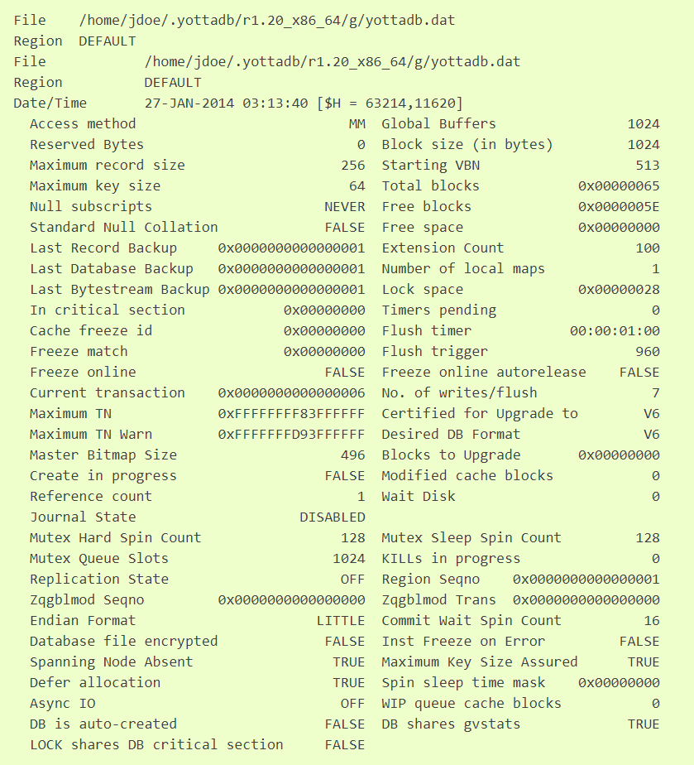
DSE File Header (Cont.)
To view the file header for the UBG region:
DSE>FIND -REGION=UBG
File /ydbinst/gbls/mumps.ubg
Region UBG
DSE>DUMP -FILEHEADER

Slide 66
Global Directory Editor (GDE)
The Global Directory Editor (GDE) is a tool used for creating, examining, and modifying global directories
A global directory is a file that identifies:
global variables mapped to database files
size limits for names and values of globals
other database characteristics
All M programs that use the same global directory share all the same global variables

Slide 67
GDE Functions
The main functions of the global directory editor are to:
define the mapping of global variables to database files
define the character limitations of global variable names and records
provide the M Peripheral Interchange Program (MUPIP) with the characteristics (e.g., -ALLOCATION size) used in creating and extending a database file

Slide 68
Accessing GDE
After defining the environment, enter M.
From the YDB prompt, execute the following:
YDB>D ^GDE
GDE>

Slide 69
To leave GDE
Use the GDE EXIT command to save all changes and return to the shell.
GDE> EXIT
Use the GDE QUIT command to discard all changes and return to the shell.
GDE> QUIT

Slide 70
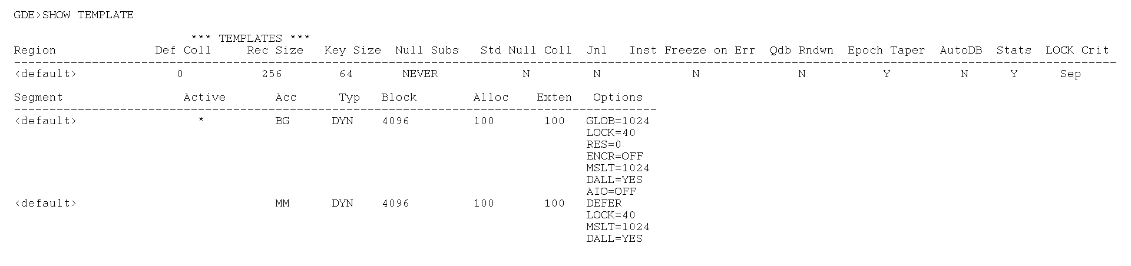
SHow (Cont.)

Slide 71
YottaDB Installation

Slide 72
YottaDB (r1.28) Supported OS Version(s)
Ubuntu 18.04 LTS
Red Hat Enterprise Linux 7.6
Debian GNU/Linux 10 (Buster)

Slide 73
YottaDB Traditional Installation
In this scenario, we will install YottaDB r1.28 for Linux on the training host
OS : Ubuntu 18.04.02
YottaDB installation package name is : yottadb_r128_linux_x8664_pro.tgz
Download from https://gitlab.com/YottaDB/DB/YDB/-/tags/r1.28
YottaDB installation directory will be : /ydb/ydb_dist_r128

Slide 74
YottaDB Traditional Installation
Install required package
$ sudo apt-get update
$ sudo apt-get install binutils
Extract YottaDB and Use “root” privilege installation package to /tmp/ydb
$ mkdir /tmp/ydb
$ cd /tmp/ydb
$ pwd
/tmp/ydb
$ tar –xzvf /home/ubuntu/yottadb_r128_linux_x8664_pro.tgz
yottadb_r124/plugin/gtmcrypt/Makefile
yottadb_r124/plugin/gtmcrypt/encrypt_sign_db_key.sh
yottadb_r124/plugin/gtmcrypt/gen_keypair.sh
yottadb_r124/plugin/gtmcrypt/gen_sym_hash.sh
yottadb_r124/plugin/gtmcrypt/gen_sym_key.sh
yottadb_r124/plugin/gtmcrypt/gtm_tls_impl.c
yottadb_r124/plugin/gtmcrypt/gtm_tls_impl.h
yottadb_r124/plugin/gtmcrypt/gtm_tls_interface.h
yottadb_r124/plugin/gtmcrypt/gtmcrypt_dbk_ref.c
yottadb_r124/plugin/gtmcrypt/gtmcrypt_dbk_ref.h
yottadb_r124/plugin/gtmcrypt/gtmcrypt_interface.h
.
.
.
.

Slide 75
YottaDB Traditional Installation
Verify that /ydb/ydb_dist_r128 is empty
$ sudo mkdir –p /ydb/ydb_dist_r128
$ ls -l /ydb/ydb_dist_r128
total 0
Run ydbinstall to install YottaDB
$ cd /tmp/ydb/yottadb_r128
$ sudo ./ydbinstall --installdir /ydb/ydb_dist_r128 --keep-obj --overwrite-existing
$ ls –l /ydb/ydb_dist_r128

Slide 76
YottaDB Environment System Variable
ydb_dist * (gtm_dist) specifies the path to the directory containing the YottaDB system distribution.
ydb_gbldir * (gtmgbldir) specifies the initial value of the $ZGBLDIR ISV. $ZGBLDIR identifies the global directory.
ydb_routines * (gtmroutines) specifies the initial value of the $ZROutines ISV, which specifies where to find object and source code.
ydb_log * (gtm_log) specifies a directory where the gtm_secshr_log file is stored.
ydb_prompt (gtm_prompt) specifies the initial value of the ISV $ZPROMPT, which controls the YottaDB direct mode prompt.
ydb_repl_instance (gtm_repl_instance) specifies the location of the replication instance file when database replication is in use.
ydb_repl_instsecondary (gtm_repl_instsecondary) specifies the name of the replicating instance in the current environment.

Slide 77
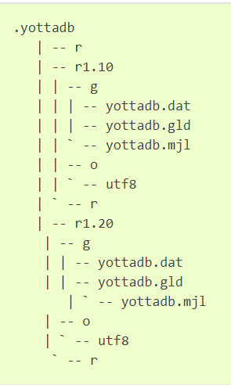
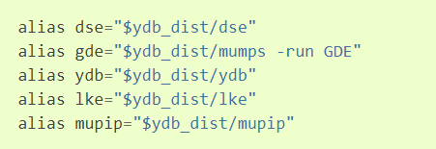
ydb_env_set (default)

Slide 78
YottaDB Installation : Customize Package
Install required package
$ sudo apt-get update
$ sudo apt-get install binutils
Download YottaDB + Octo packages
$ cd /tmp
$ git clone https://github.com/mrockstyle/Octo
Install YottaDB + Octo
$ cd /
$ sudo tar -xzvf /tmp/Octo/ydb_dist.tar.gz
Setup YottaDB Instance
$ cd / $ sudo tar -xzvf /tmp/Octo/ydb_dir.tar.gz
$ cd /ydbdir $ sudo mv yottadb.pc /usr/share/pkgconfig/

Slide 79
YottaDB Installation : Customize Package
YottaDB Binary Path : /ydb/ydb_dist_r128
YottaDB Instance Path : /ydbdir
Instance Database File Path : /ydbdir/gbls/

Slide 80
YottaDB DB Structure

Slide 81
Global Directory file
Store YottaDB DB structure configuration.
Reference from $ydb_gbldir ($gtmgbldir) system variable.
View and manage by ”GDE” command

Slide 82
Table / Global / Data File Mapping
YottaDB provides flexibility in database configuration by allowing each process to distribute its logically monolithic global variable name space across an arbitrary number of database files with the aid of a global directory file.

Slide 83
NAME
The NAMES section contains mappings of M global name spaces. More than one name space can map to a single region and a single name space can map to more than one region.
A name space:
Is case-sensitive
Must begin with an alphabetic character or a percent sign (%).
Can be a discrete “global” name, for example, aaa corresponds to the global variable ^aaa.
Can be a global name ending with a wild card (“*”), for example, abc* represents the set of global nodes which have abc as the starting prefix.
Can be a subtree of a global name, for example, abc(1) represents a subtree of the global ^abc.
Can be a subscript range, for example, abc(1:10) represents all nodes starting from ^abc(1) up to (but not including) to ^abc(10).
A global name can be one to 31 alphanumeric characters. However, the combined length of a global and its subscripts is limited to 1,019 bytes (the maximum key size supported by YottaDB). Note that the byte length of the subscripted global specification can exceed the maximum KeySize specified for its region.
Maps to only one region in the Global Directory.

Slide 84
REGION
A region is a logical structure that holds information about a portion of a database, such as key-size and record-size. A key is the internal representation of a global variable name. In this chapter the terms global variable name and key are used interchangeably. A record refers to a key and its data
A Global Directory must have at least one region. A region only maps to a single segment. More than one name may map to a region
A region name:
Must begin with an alphabetic character, except for $DEFAULT
Can include alphanumeric, dollar signs ($), and underscores ( _ )
Can have from 1 to 16 characters
GDE automatically converts region names to uppercase, and uses DEFAULT for the default region name

Slide 85
SEGMENT
A segment defines additional database storage characteristics . A segment must map to a single file. A segment can be mapped by only one region
YDB uses a segment to define a physical file and access method for the database stored in that file
A segment-name:
Must begin with an alphabetic character, except for $DEFAULT
Can include alphanumeric, dollar signs ($), and underscores ( _ )
Can have from 1 to 16 characters
GDE automatically converts segment names to uppercase. GDE uses DEFAULT for the default segment name

Slide 86
FILE
Files are the structures provided by UNIX for the storage and retrieval of information. Files used by YDB must be random-access files resident on disk
By default, GDE uses the file-name mumps.dat for the DEFAULT segment. The .dat extension is added to the file name unless an extension is specified

Slide 87
GDE : SHow Command
The SHOW command displays information contained in the Global Directory about names, regions, and segments
The format of the SHOW command is:
SH[OW]
SH[OW] -A[LL]
SH[OW] -C[OMMAND] -F[ILE]=[gde-command-file]
SH[OW] -N[AME] [name-space]
SH[OW] -R[EGION] [region-name]
SH[OW] -S[EGMENT] [segment-name]
SH[OW] -M[AP] [R[EGION]=region-name]
SH[OW] -T[EMPLATE]
SH[OW] -A[LL]

Slide 88
GDE Example
The example below is intended to illustrate how the GDE utility delineates the mapping schema of the example provided above. In this example, we are using two database files, UBG and TBLS. (Actual schema will vary depending upon an individual institution’s needs.)
GDE> Show

Slide 89
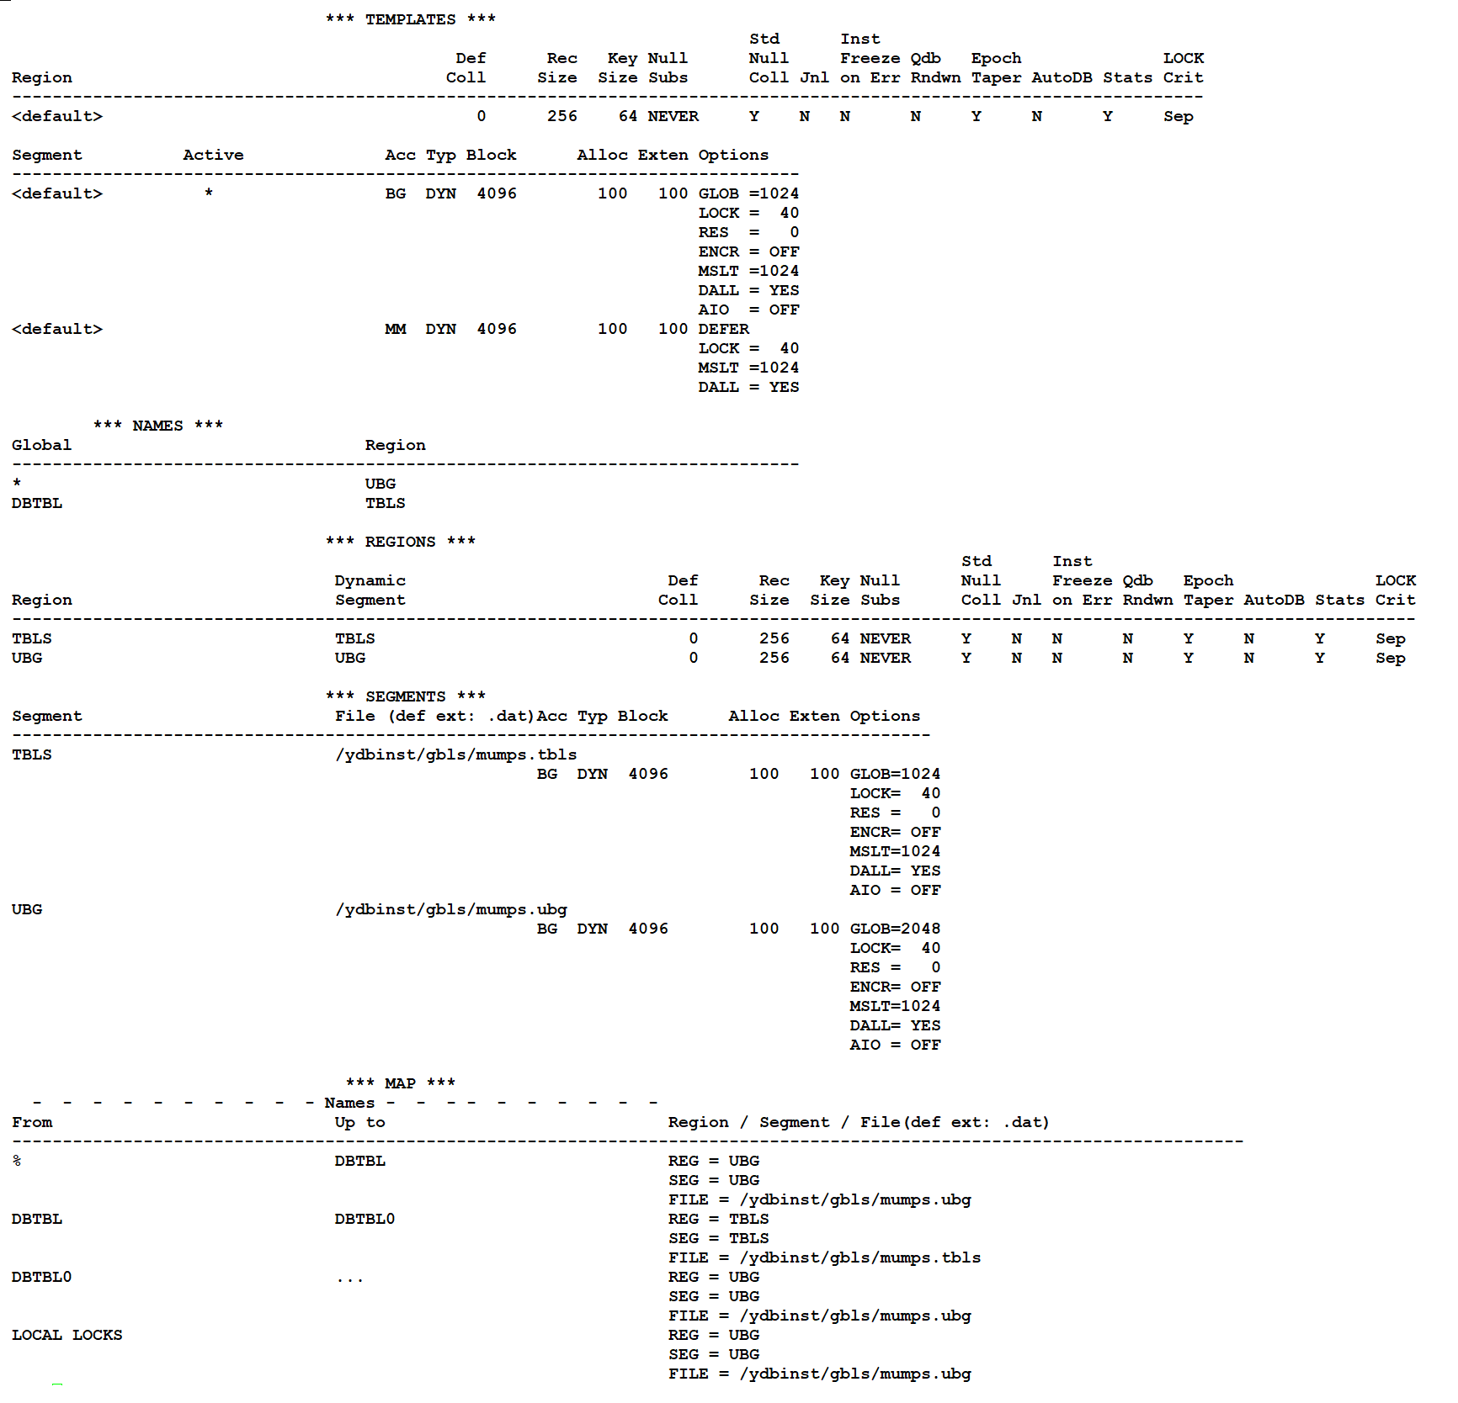
GDE Example (Result)

Slide 90
Question and Answer

